Slide 1
WELCOME MY HOME ★
발표자 : 조 영 아

Slide 2
WELCOME MY HOME ★
▲
Click

Slide 3

HOME
ABOUT
PORTFOLIO
CONTACT

Slide 4
HOME
ABOUT
PORTFOLIO
CONTACT
ABOUT

Slide 5





HOME
ABOUT
PORTFOLIO
CONTACT
KEY WORD
따뜻한 마음
불꽃같은 열정
긍정마인드
말보다는 행동
인내심

Slide 6

HOME
ABOUT
PORTFOLIO
CONTACT
PROFILE
NAME
조영아
BIRTE
1990.12.24
EDUCAION
완산여자고등학교 2006.03 ~ 2009.02
전주대학교 회계세무 전공 2009.03 ~ 2014.02
그린컴퓨터아트학원 2023.06 ~ 2023.10
‘ UI/UX반응형 웹디자인&웹퍼블리셔(코딩) 개발자B ’

Slide 7







HOME
ABOUT
PORTFOLIO
CONTACT
CERTIFICATE
SKILLS
★ 컴퓨터활용능력 2급
Photoshop
★ 전산회계 1급
Illustrator
★ 정보처리기능사
Html
css
JavaScript
ABILITY

Slide 8
HOME
ABOUT
PORTFOLIO
CONTACT
PORTFOLIO

Slide 9

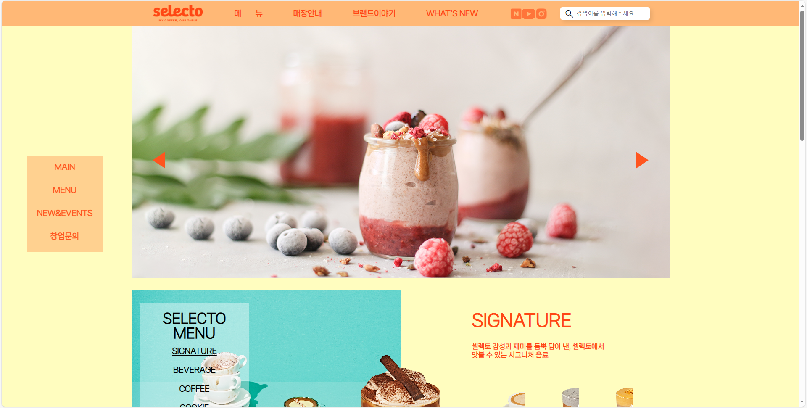




HOME
ABOUT
PORTFOLIO
CONTACT
PROJECT
Selecto
Color
Tool

Slide 10
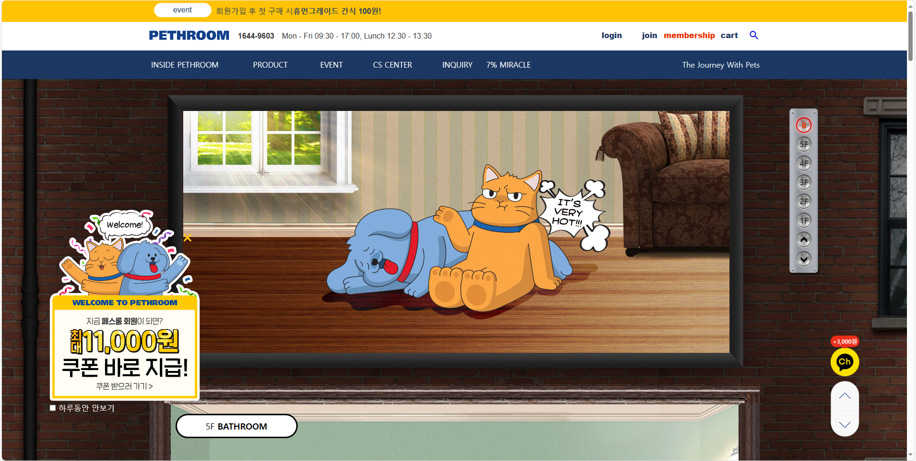
HOME
ABOUT
PORTFOLIO
CONTACT
PROJECT
Pethroom
Color
Tool

Slide 11
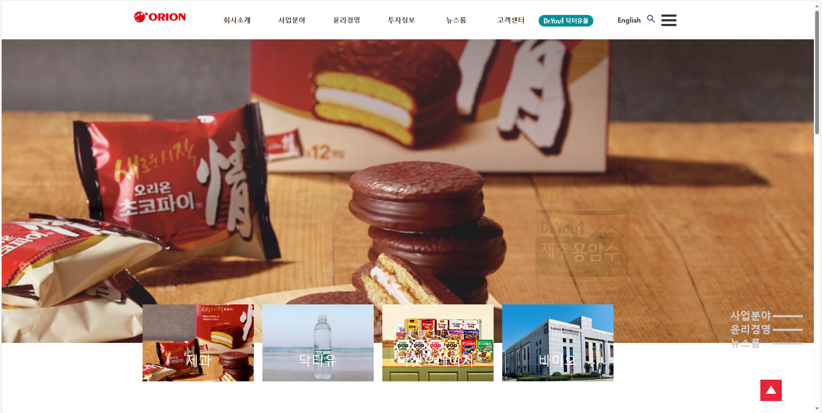
HOME
ABOUT
PORTFOLIO
CONTACT
PROJECT
Orion
Color
Tool

Slide 12
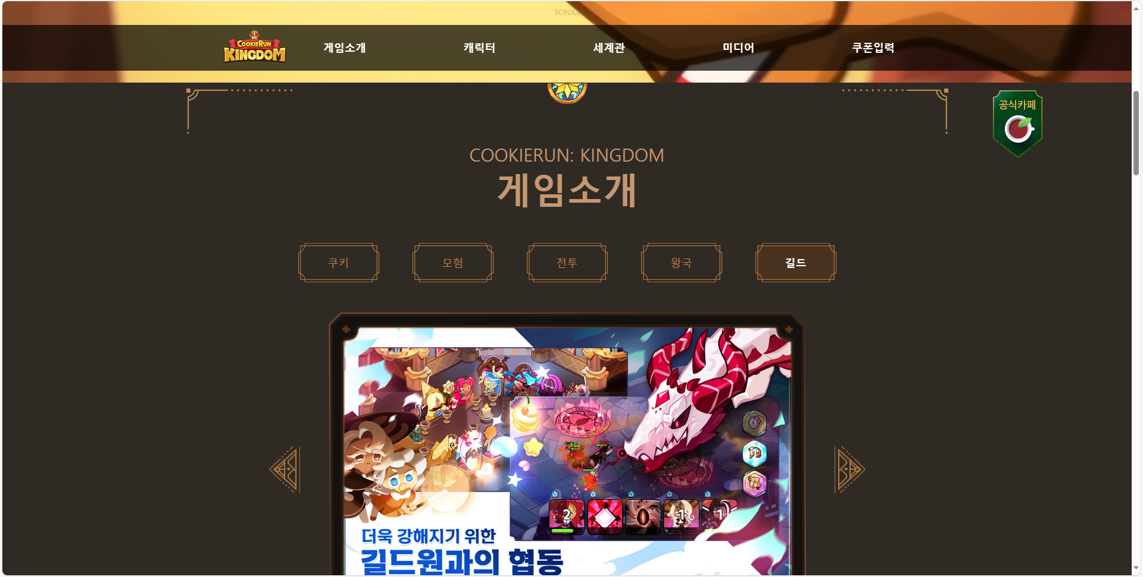


HOME
ABOUT
PORTFOLIO
CONTACT
PROJECT
Cookierun-kingdom
Color
Tool

Slide 13
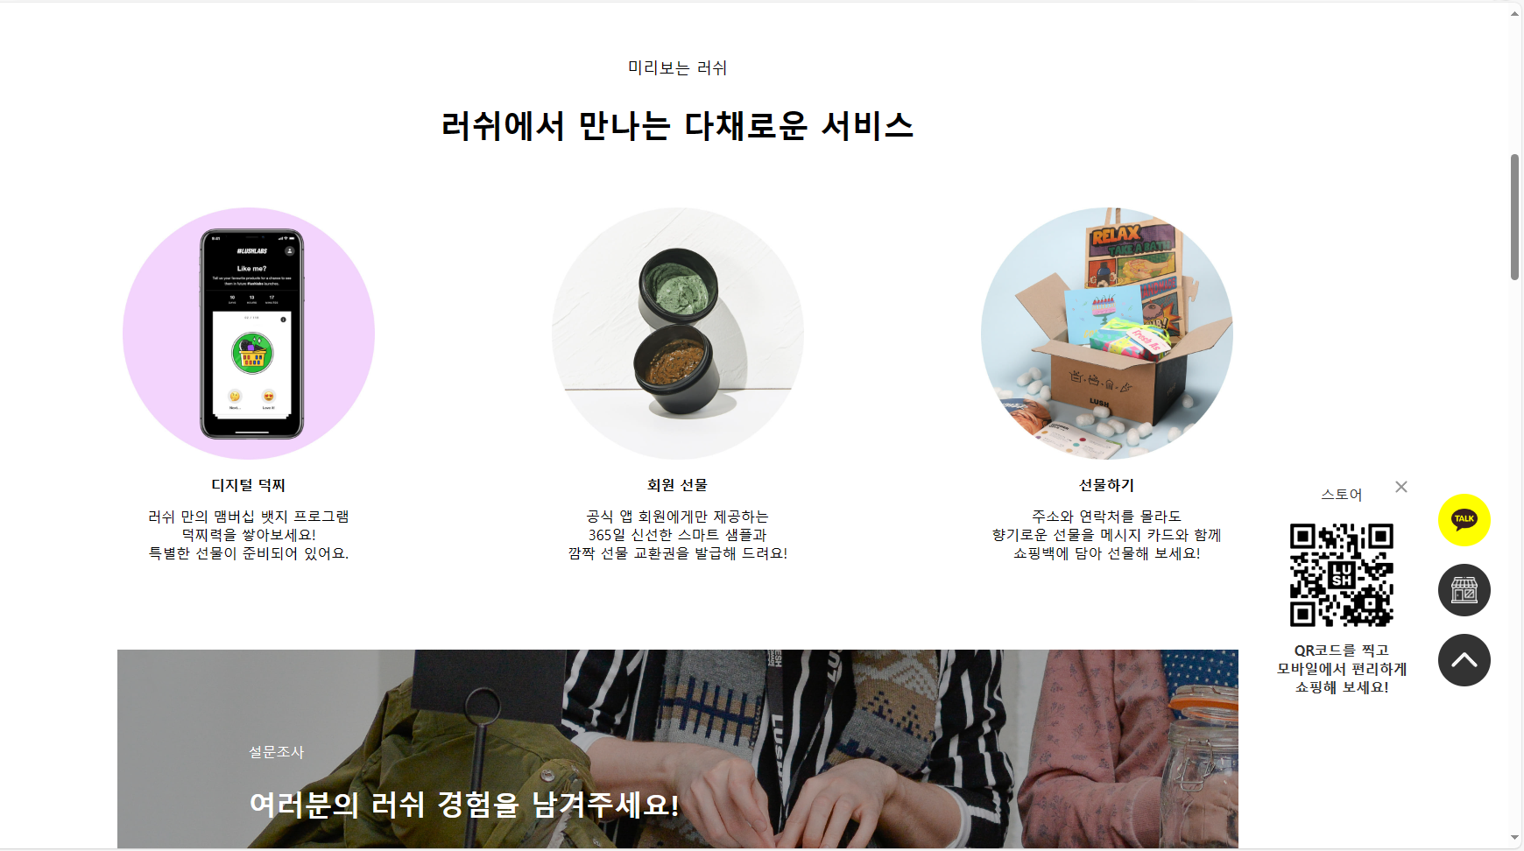
HOME
ABOUT
PORTFOLIO
CONTACT
PROJECT
Lush
Color
Tool

Slide 14
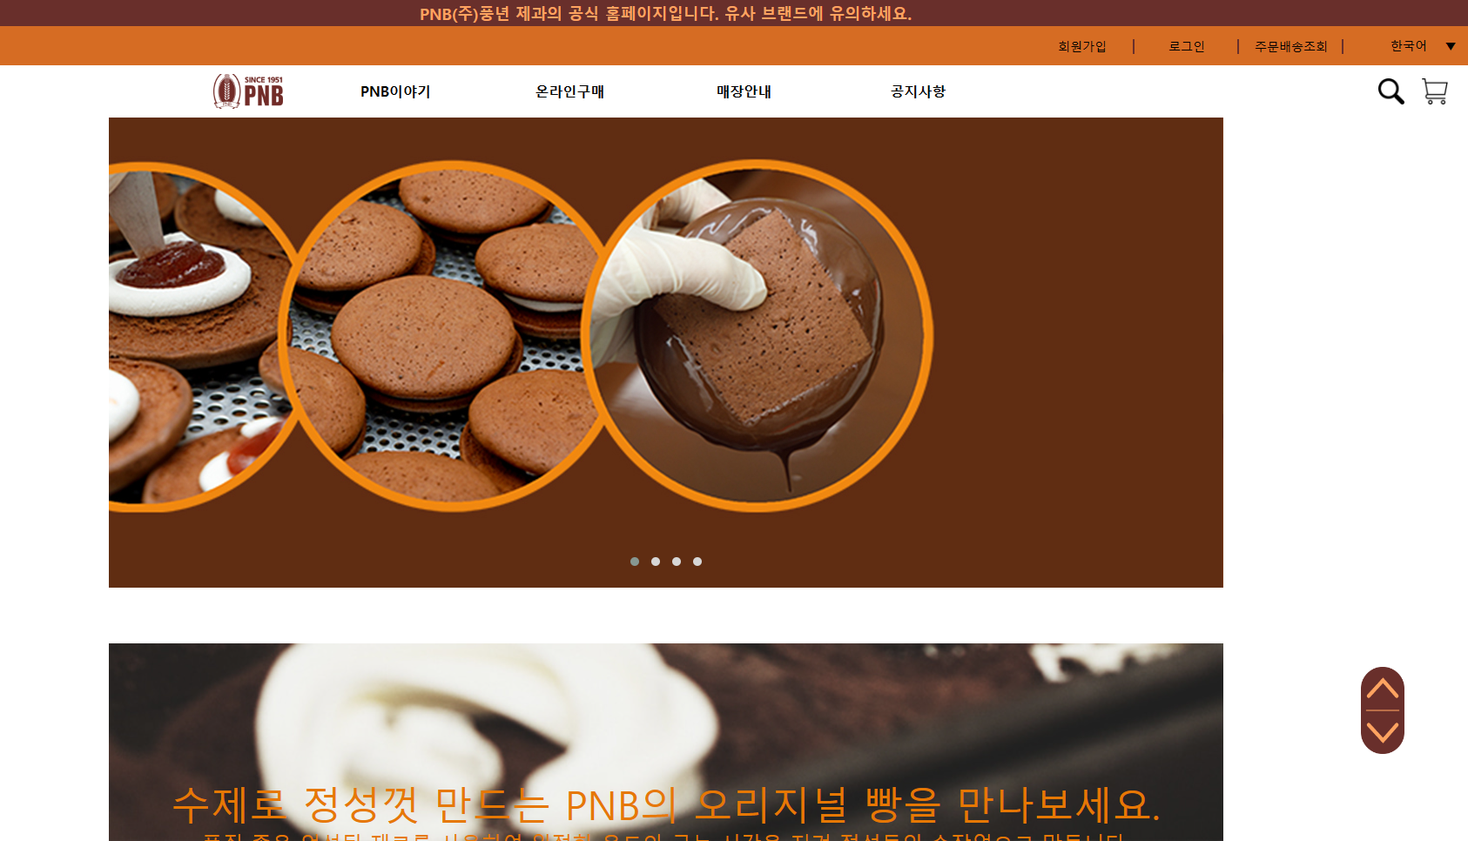
HOME
ABOUT
PORTFOLIO
CONTACT
PROJECT
PNB1951
Color
Tool

Slide 15
HOME
ABOUT
PORTFOLIO
CONTACT
CONTACT

Slide 16

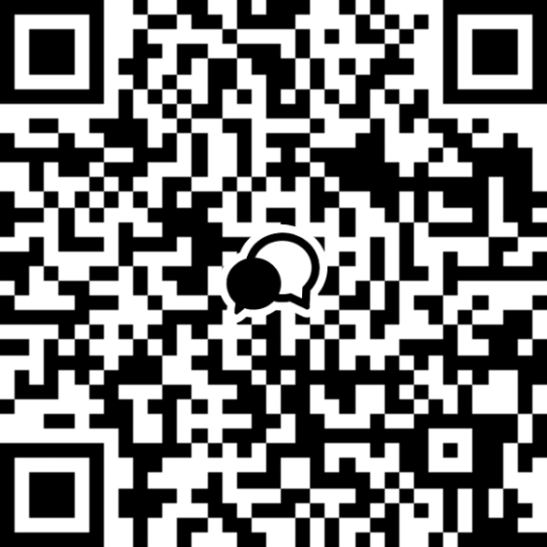
HOME
ABOUT
PORTFOLIO
CONTACT
OPENKAKAO TALK
▲
click

Slide 17
HOME
ABOUT
PORTFOLIO
CONTACT
PHONE
010 3848 0257
E-MAIL
owoya00@gmail.com
▲
click

Slide 18
HOME
ABOUT
PORTFOLIO
CONTACT
DETAILED

Slide 19


HOME
ABOUT
PORTFOLIO
CONTACT
FOCUS
LOGO
BUTTONS
Normal
Click

Slide 20








HOME
ABOUT
PORTFOLIO
CONTACT
COLOR PALETTE
★ ★
PRIMARY
★ ★ ★
SECONDARY
#FFFFFF
#FFFF00
#A1D1F1
#CCE9F9
#5BA7D5
#184965
#1E4E7
#62B6CC
TYPOGRAPHY
Open Sans
Open Sans
나눔스퀘어라운드 Regular
나눔스퀘어라운드 ExtraBold

